Slide 1

Pedestrian Tracking
Team: High Distinction
Members: Fengrui Yang, Haoyu Sun, Qiyao Zhou, Xiaohang Hu, Zheng Cao

Slide 2
Introduction
Haoyu Sun

Slide 3
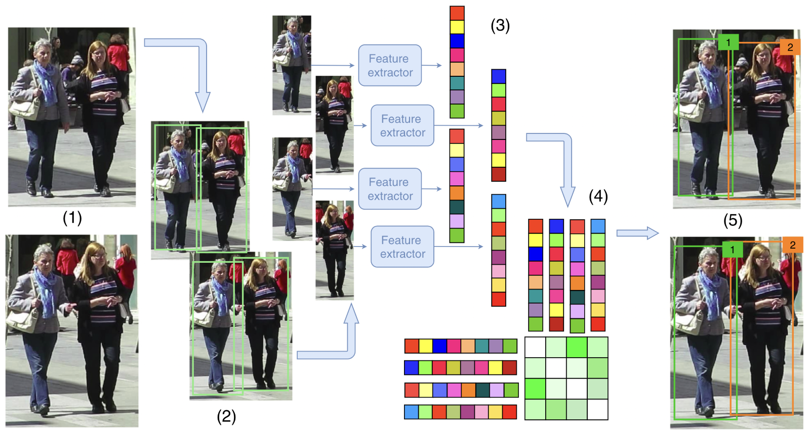

Methods

Slide 4
Pedestrian Detection and Tracking:
1. We use yolov5m with label “people” to train our own model based on MOT.
2. use yolo to do pedestrian detection which can help us locate a detected pedestrian in a single frame with bounding box.
3. we use deep sort Tracking to find pedestrian that persists across multiple frames with pedestrian id.

Slide 5
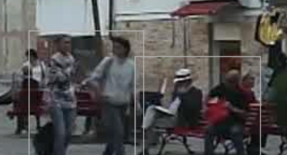
Detect pedestrians in a group
through the box’s width and height to estimate the distance to the camera
two people’s positions are about the same and their boundaries box is similar.
Reduce the area to 80% for sitting person

Slide 6
Pedestrians entering or leaving the scene
Entering
check the boundary area of window, trying to find box that is very close to the boundary and just appear.
check if the pedestrian is getting closer to the center of the window
Leaving
Otherwise, if pedestrians are getting away from the center of the scene and moving to the boundary of the scene

Slide 7
Algorithms
Use the average of the last 10 rectangles
Trajectory
Calculate the distance between each rectangle, only keep the rectangle far away from last rectangle
Group
The size of a pedestrian(area of the rectangle) is inversely proportional to their distance from the camera
The unit of measure is inversely proportional to the camera distance
Reduce the area to 80% for sitting person

Slide 8
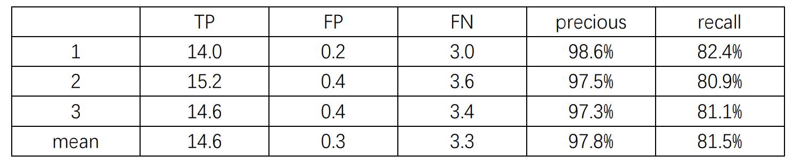
Evaluation and Results
Precious = TP/(TP+FP)
Recall = TP/(TP+FN)

Slide 9
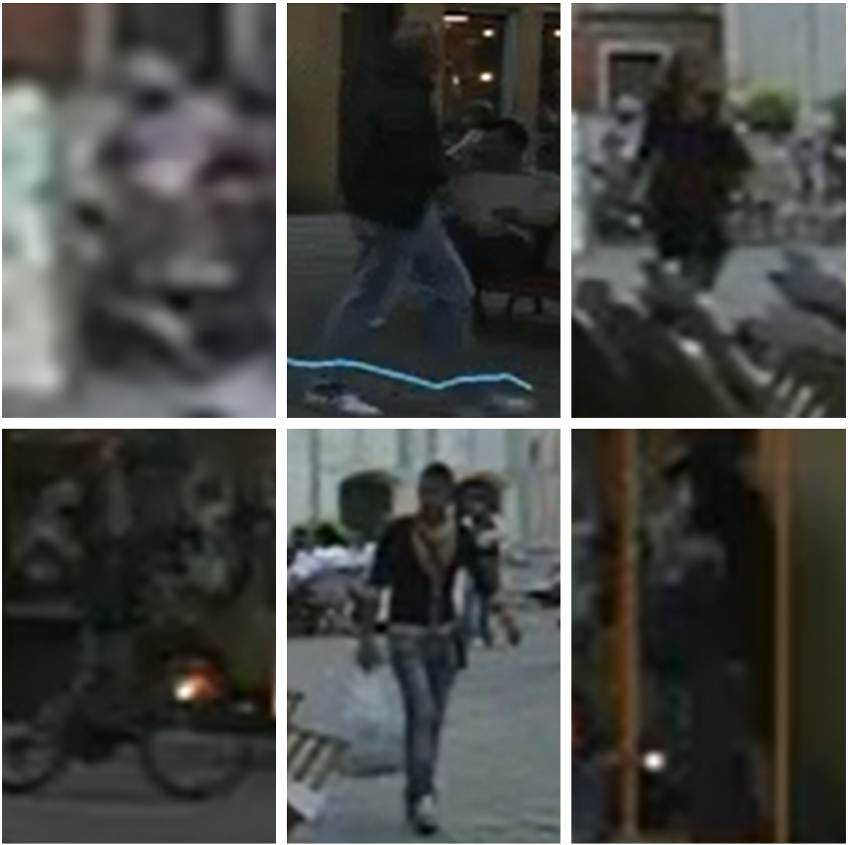

Slide 10
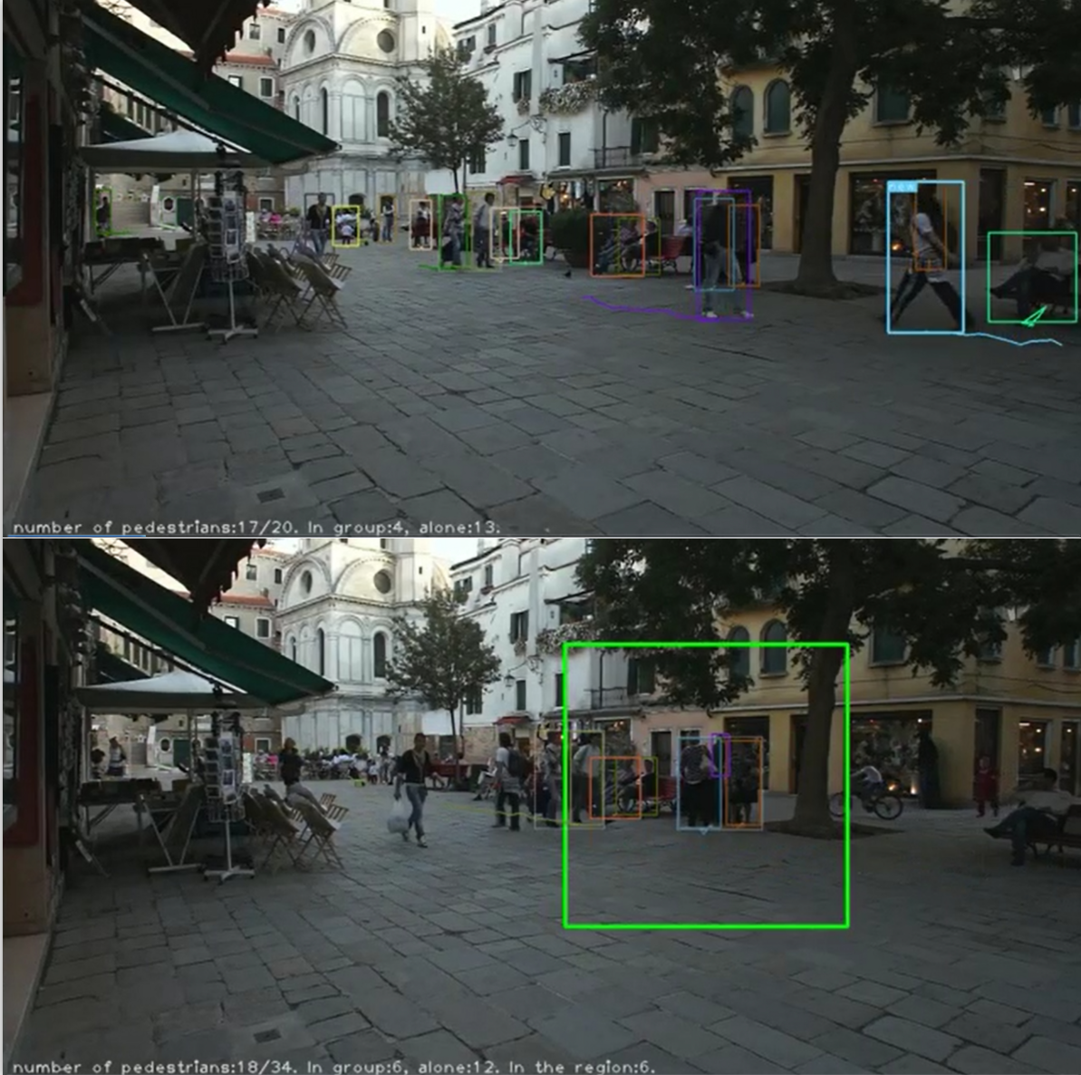

Slide 11
Discussion and Conclusion
Fengrui Yang

Slide 12
Software Demonstration
Xiaohang

